Slide 1
Consumer Attitudes towards Luxury
China, May 2017

Slide 2
Methodology
Online survey was conducted in February 2017
City Coverage:
  Tier one cities: Beijing, Shanghai, Guangzhou and Chengdu
  Tier two cities: Dalian, Hefei and Changsha
  Tier three cities: Datong, Quanzhou and Weifang
All respondents have monthly household income is higher than RMB 20,000 in tier one cities or higher than RMB 18,000 in tier two and three cities, to ensure that surveyed consumers have the feasibility to purchase luxury branded items and luxurious experiences/services at least occasionally.
Classify consumers into two groups based on monthly household income to better identify the differences within Chinese financially stable consumers.
  Lower monthly household income: RMB 20,000-30,000 (Tier one cities), RMB 18,000-24,000 (Tier two and three cities)
  Higher monthly household income: RMB 30,000 or above (Tier one cities), RMB 24,000 or above (Tier two and three cities)
Define luxury buyers and non-buyers based on their purchase history
  Luxury buyers: who have bought any luxury branded items in the last 18 months
  Luxury non-buyers: who have not bought any luxury branded items in the last 18 months

Slide 3
Luxury Consumers Overview

Slide 4
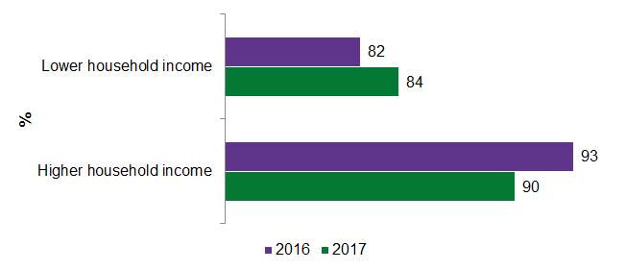
Luxury market is no longer exclusive domain of the super-rich
Higher household income leads to higher number of luxury brand buyers
Slightly more consumers with lower household income and slightly fewer consumers with higher household income are luxury buyers in 2017 as compared to last year.
When monthly personal income has risen to RMB 5,000-9,000, the number of luxury brand buyers increased to 87% with a 17 percentage point difference, while there is only a six percentage point increase as monthly personal income goes up to RMB 10,000 or above.
FIGURE 1: COMPARISON OF THE NUMBER OF BUYERS OF LUXURY BRANDED ITEMS IN 2016 AND 2017, FEBRUARY 2017 AND JUNE 2016
Note: In this research, “any luxury branded items” are based on their own definition of luxury brands, while in Mintel’s Luxury retailing – China, December 2016 Report, “any luxury branded items” are from brands that are positioned at the very top end of any market (eg Chanel, Louis Vuitton, Gucci, Hermès, Rolex, Mont Blanc, Dunhill, Prada, Burberry, Versace and Tiffany) and not premium mass brands (eg Esprit, Tissot, SWAROVSKI)
Base: 3,000 internet users aged 20-49 in 2017; 1,937 internet users aged 20-49 in 2016 whose monthly household income is higher than RMB 20,000 in tier one cities or higher than RMB 18,000 in tier two and three cities
Source: QQSurvey/Mintel

Slide 5
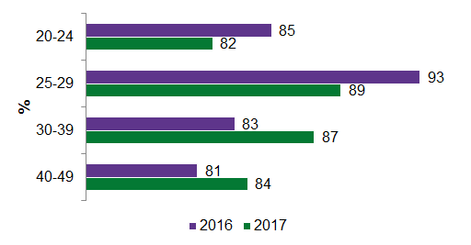
Driven by consumers aged 25-39
25-29s are not the only age group that is of great importance to luxury brands.
30-39s tend to have a higher possibility to be more financially stable than those aged 25-29.
20-24s have purchased fewer luxury branded items, while 40-49s have shown stronger inclination to buy luxury, indicating the demand for more products and services catering to mature consumers.
25-39s are more eager to buy luxury from a wider range of categories (products & experiences).
FIGURE 2: BUYERS OF LUXURY BRANDED ITEMS, BY AGE, FEBRUARY 2017 AND JUNE 2016
Note: In this research, “any luxury branded items” are based on their own definition of luxury brands, while in Mintel’s Luxury retailing – China, December 2016 Report, “any luxury branded items” are from brands that are positioned at the very top end of any market (eg Chanel, Louis Vuitton, Gucci, Hermès, Rolex, Mont Blanc, Dunhill, Prada, Burberry, Versace and Tiffany) and not premium mass brands (eg Esprit, Tissot, SWAROVSKI)
Base: 3,000 internet users aged 20-49 in 2017; 1,937 internet users aged 20-49 in 2016 whose monthly household income is higher than RMB 20,000 in tier one cities or higher than RMB 18,000 in tier two and three cities
Source: QQSurvey/Mintel

Slide 6
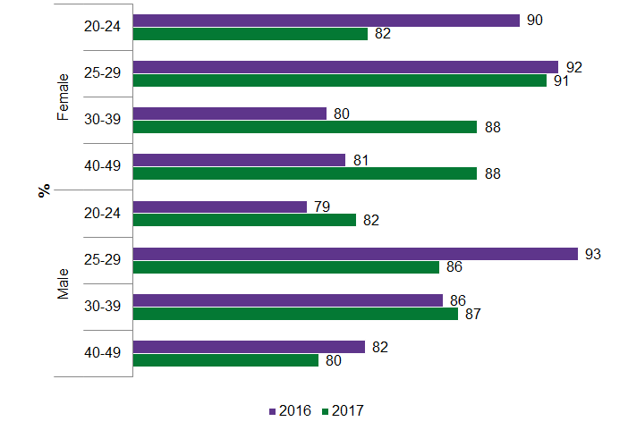
Future trends among 20-24 females: seeking unique things to stand out but more price-conscious and practical-value-driven
Women generally drive luxury markets more than men, likely driven by more and more affordable luxury brands and products, whose reasonable prices are a good trigger for mature females to buy as a gift for their children or to thank someone.
Luxury brand buyers shift from young towards mature females.
Female 20-24s bought less luxury and male 20-24s increased luxury purchase, likely because young women are significantly more interested in luxurious experiences (eg fine dining, travelling) (vs luxury branded products), practical features of luxury branded items (vs the design aesthetics), and standard luxury items (vs customisation).
FIGURE 3: BUYERS OF LUXURY BRANDED ITEMS, BY AGE AND GENDER, FEBRUARY 2017 AND JUNE 2016
Note: In this research, “any luxury branded items” are based on their own definition of luxury brands, while in Mintel’s Luxury retailing – China, December 2016 Report, “any luxury branded items” are from brands that are positioned at the very top end of any market (eg Chanel, Louis Vuitton, Gucci, Hermès, Rolex, Mont Blanc, Dunhill, Prada, Burberry, Versace and Tiffany) and not premium mass brands (eg Esprit, Tissot, SWAROVSKI)
Base: 3,000 internet users aged 20-49 in 2017; 1,937 internet users aged 20-49 in 2016 whose monthly household income is higher than RMB 20,000 in tier one cities or higher than RMB 18,000 in tier two and three cities
Source: QQSurvey/Mintel

Slide 7
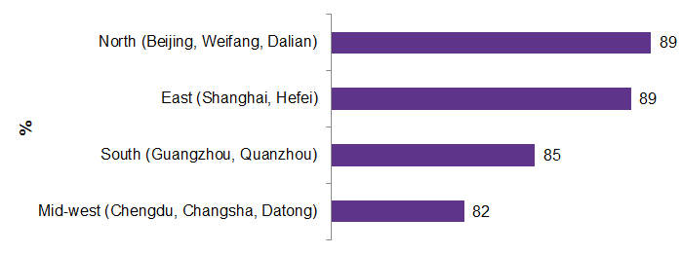
Consumers from middle and western China buy fewer luxury items
Consumers in tier one cities have not bought more luxury branded items than those in lower tier cities, likely because the cost of living (eg education investment, property rates) in tier one cities is also relatively higher than living in lower tier cities.
58% of luxury non-buyers in middle and western China have stronger desire to buy luxury (eight percentage points) than the average of consumers in North, East and South.
So lower purchase rate could be partly caused by lower availability of luxury brand stores and outlets and lower variety of luxury branded items sold in the middle and western market.
FIGURE 4: BUYERS OF LUXURY BRANDED ITEMS, BY REGION, FEBRUARY 2017
Base: 3,000 internet users aged 20-49 in 2017
Source: QQSurvey/Mintel

Slide 8
THE CONSUMER
Attitudes towards luxury category
Preferences towards luxury brands
Luxury purchase occasions and emotions
Luxury purchase behaviours and habit
The classification of luxury consumers

Slide 9
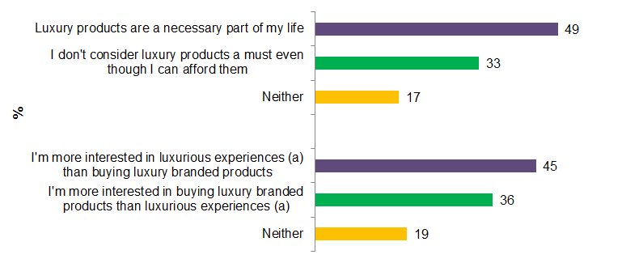
Desire to buy luxury is obvious, especially luxurious experiences
FIGURE 5: ATTITUDE TOWARDS LUXURY BRANDED ITEMS AND LUXURIOUS EXPERIENCES, FEBRUARY 2017
“Below are several pairs of statements about luxury brands. For each pair, please select the one that you agree more with. (Single code per row)”
Note: a: eg fine dining, travelling
Base: 3,000 internet users aged 20-49 in 2017
Source: QQSurvey/Mintel

Slide 10
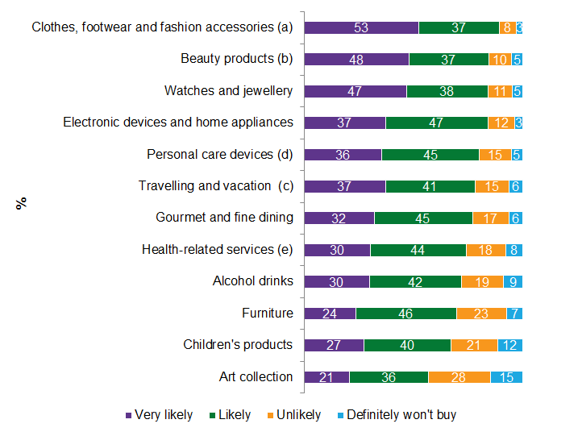
…as well as causal goods (eg apparel, footwear, fashion and beauty products)
FIGURE 6: LIKELIHOOD TO PURCHASE LUXURY ACROSS CATEGORIES, FEBRUARY 2017
“How likely are you going to buy each of the following categories of luxury branded items or luxury experiences in the next 12 months? (Single code per row)”
Note: a : eg hats, scarves, gloves
b: eg cosmetic, skincare, perfume
c: eg living in five star hotel, first class flight
d: eg electronic toothbrushes, shavers, facial cleansers
e: eg yoga, spa treatment
Base: 3,000 internet users aged 20-49 in 2017
Source: QQSurvey/Mintel

Slide 11
THE CONSUMER
Attitudes towards luxury category
Preferences towards luxury brands
Luxury purchase occasions and emotions
Luxury purchase behaviours and habit
The classification of luxury consumers

Slide 12
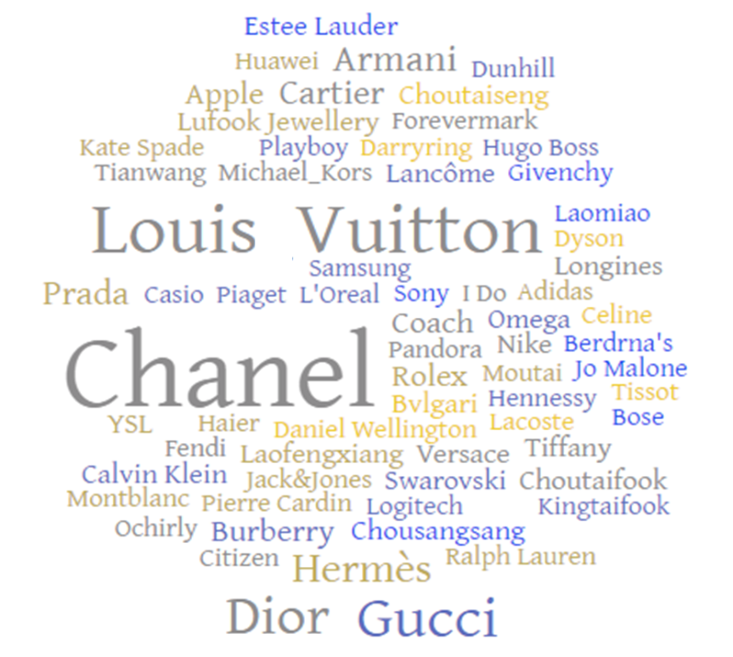
Consumers are not yet experts in luxury classification
When asking consumers to list the luxury brands they most recently paid for, premium brands such as Nike, Adidas, Apple, Sony, Huawei, Samsung and Dyson, which normally do not belong to the luxury world, are also mentioned spontaneously by a small number of surveyed consumers
FIGURE 7: WORD CLOUD OF LUXURY BRANDS THAT CONSUMERS HAVE BOUGHT IN THE LAST 18 MONTHS, FEBRUARY 2017
“You mentioned that you’ve bought luxury items in the last 18 months (including for yourself and for others). What’s the brand name/service provider of the luxury item you bought last time? (Open-ended)”
Base: 3,000 internet users aged 20-49 in 2017
Source: QQSurvey/Mintel

Slide 13
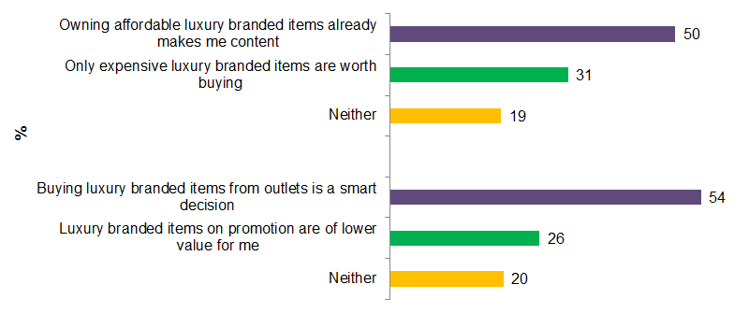
Differences between luxury brands from different tiers are not acknowledged
Consumers are not very picky about luxury brand tiers and quite open to purchasing inexpensive luxury items, partly because of their practical, function-driven shopping mindset.
Due to limited luxury knowledge, some Chinese consumers tend not to acknowledge the importance of brand value, leading them to see luxury as a collective concept.
FIGURE 8: ATTITUDE TOWARDS AFFORDABLE/DISCOUNT LUXURY BRANDED ITEMS, FEBRUARY 2017
“Below are several pairs of statements about luxury brands. For each pair, please select the one that you agree more with. (Single code per row)”
Base: 3,000 internet users aged 20-49 in 2017
Source: QQSurvey/Mintel

Slide 14
THE CONSUMER
Attitudes towards luxury category
Preferences towards luxury brands
Luxury purchase occasions and emotions
Luxury purchase behaviours and habit
The classification of luxury consumers

Slide 15
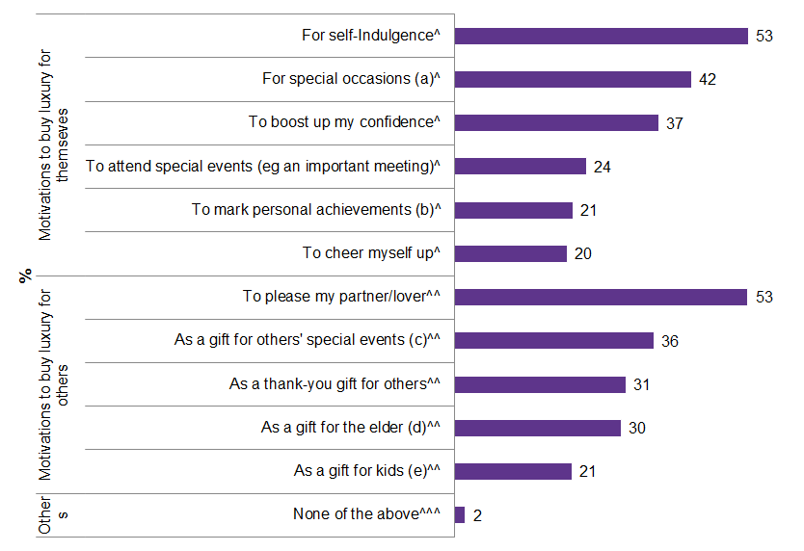
The main motivation to purchase luxury: pleasure and self-indulgences
FIGURE 9: LUXURY PURCHASE OCCASIONS, FEBRUARY 2017
“Which of the following reasons motivated you to buy luxury items in the past 18 months? (Multicode)”
Note:
^Based on 2259 internet users aged 20-49 who have bought luxury branded items for themselves
^^Based on 1131 internet users aged 20-49 who have bought luxury branded items for others
^^^Based on 2576 internet users aged 20-49 who are luxury buyers
a: eg birthday, anniversary, wedding
b: eg graduation, got first job, got promoted
c: eg for their birthday, wedding day
d: eg Mother's day
e: eg their birthday or achievements
Base: 3,000 internet users aged 20-49 in 2017
Source: QQSurvey/Mintel

Slide 16
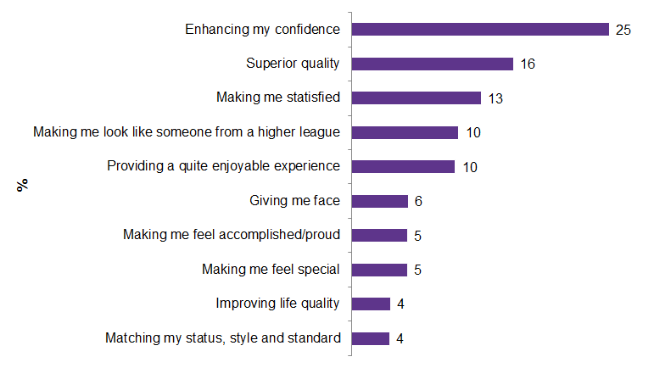
Use emotions to sell
Less about superiority, more about self-improvement and satisfaction
High price does not have the closest relationship with luxury.
Brand unique identity and exclusivity are somehow neglected
FIGURE 10: TOP 10 EMOTIONS ASSOCIATED WITH LUXURY PURCHASE, FEBRUARY 2017
“Compared to other premium brands, what do you think are the exclusive feelings that a luxury products/experience can provide you? (Open-ended)”
Base: 3,000 internet users aged 20-49 in 2017
Source: QQSurvey/Mintel

Slide 17
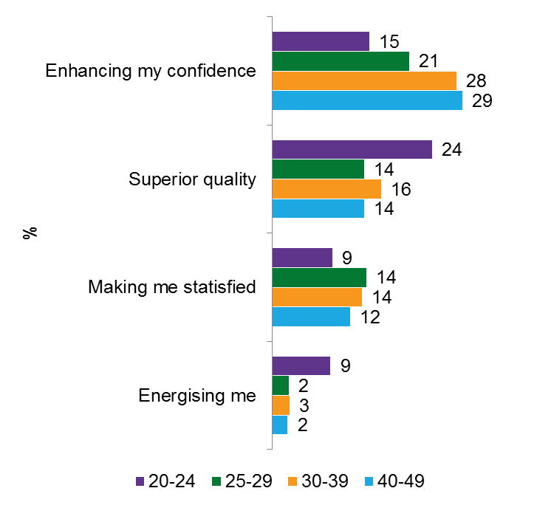
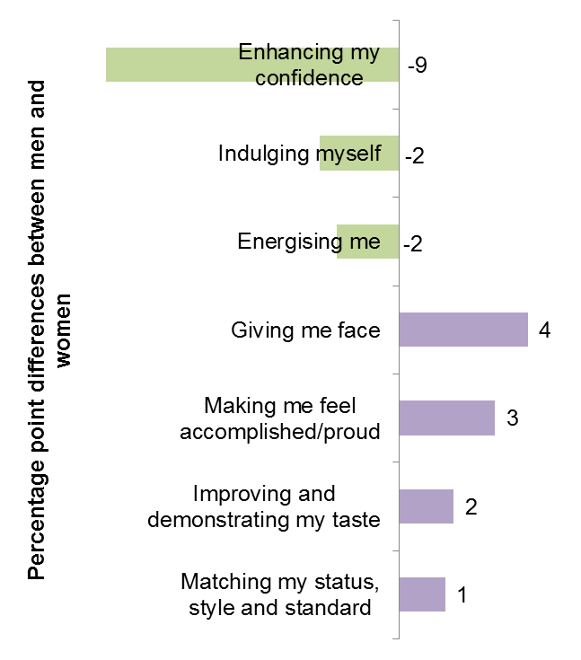
Marketing strategy needs to be adaptive to age and gender differences
FIGURE 11: EMOTIONAL ASSOCIATIONS ACROSS AGES, FEBRUARY 2017
FIGURE 12: EMOTIONAL ASSOCIATIONS ACROSS GENDERS, FEBRUARY 2017
Note: Green bar indicates emotional associations skewing towards females and purple bar indicates emotional associations skewing towards males
Base: 3,000 internet users aged 20-49 in 2017
Source: QQSurvey/Mintel

Slide 18
THE CONSUMER
Attitudes towards luxury category
Preferences towards luxury brands
Luxury purchase occasions
Luxury purchase behaviours and habit
The classification of luxury consumers

Slide 19
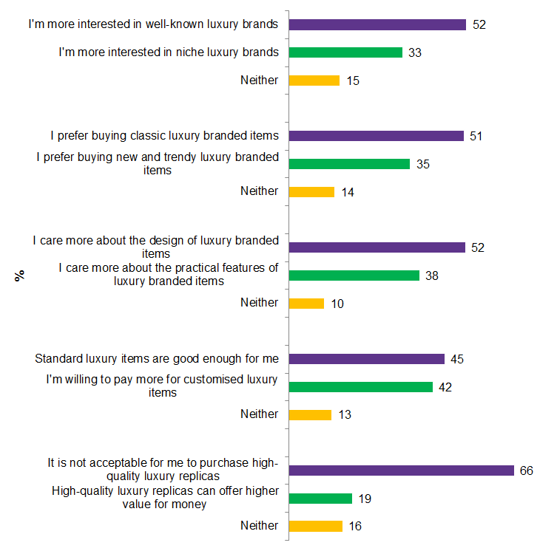
Purchase preferences: well-known brands and products that are classic, authentic and beautifully designed
FIGURE 13: PREFERENCES TOWARDS LUXURY BRANDS AND PRODUCTS, FEBRUARY 2017
Chinese financially stable consumers are more drawn to luxury brands and products that are instantly recognisable.
The value of luxury customisation is not yet fully recognised, likely because owning a luxury branded item itself is already a good way to show uniqueness and superiority to some consumers.
Seek smart ways to purchase luxury and a small number of consumers do consider replicas
Distribution channels need to embody a high level of credibility so that consumers would not have doubts around the genuineness of products or have a negative association with the brand.
Base: 3,000 internet users aged 20-49 in 2017
Source: QQSurvey/Mintel

Slide 20
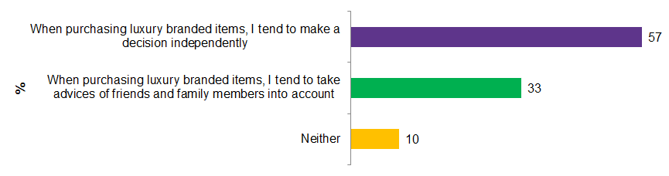
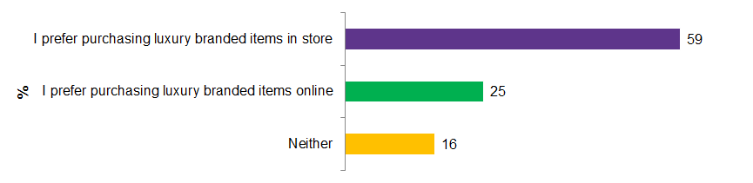
Require more information and help during purchase - especially online, as online purchase is becoming a mainstream
FIGURE 14: LUXURY PURCHASE DECISION-MAKER, FEBRUARY 2017
FIGURE 15: PREFERENCES TOWARDS LUXURY PURCHASE CHANNELS, FEBRUARY 2017
Base: 3,000 internet users aged 20-49 in 2017
Source: QQSurvey/Mintel

Slide 21
THE CONSUMER
Attitudes towards luxury category
Preferences towards luxury brands
Luxury purchase occasions
Luxury purchase behaviours and habit
The classification of luxury consumers

Slide 22
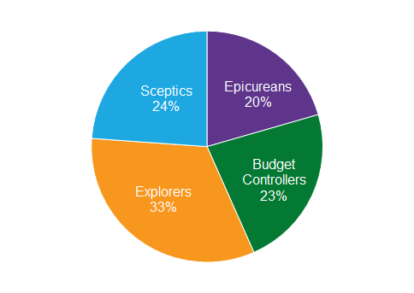
Four types of luxury consumers
Epicureans (享乐主义者): big spender devoted to sensual pleasures
Budget Controllers (预算控制者): meticulous about how to spend money
Explorers (探索者) : positive-minded consumers who tend to say yes to every idea
Sceptics (怀疑者): not entirely sure about their preferences and desires
FIGURE 16: CONSUMER SEGMENTATION BASED ON THEIR ATTITUDES TOWARDS LUXURY, FEBRUARY 2017
Base: 3,000 internet users aged 20-39
Source: QQSurvey/Mintel

Slide 23
Who are they?
Explorers have high level of confidence about their future financial status, but this does not stop them from having the strongest desire to shop smartly. Explorers have a positive mind and tend to say yes to all kinds of new adventures and experiences, including trying delicious food and drinks, developing hobbies, taking participant in cultural activities and travelling. They are always seeking physical and emotional excitements in everyday life. They have greater potential to grow to become connoisseurs of luxury and pay premium for brand unique identity. Very expensive luxury items, customised services, niche luxury brands and classic luxury goods are more favoured.
Unlike Explorers, Epicureans tend to be big spenders who have the lower level of desire in seeking deals and discounts. Their core need is sensual pleasures, which is also where they spend most of their money. Their luxury knowledge and brand awareness are not high and tend to buy luxury brands that they already know partly because they have an old-fashioned mind and are not interested in new luxurious experiences, new shopping trends and new ways of thinking and living.
Budget Controllers have lower income, while they do not plan to lead a frugal life and tend to be quite meticulous about how to spend money. Because of their strong desire to look good in front of others, they are interested in luxury purchase. Due to their “down-to-earth” view on shopping, luxury branded items are more appealing to Budget Controllers than luxurious experiences. Well-known luxury brands, standard are affordable and discount luxury items are right up their ally.
Sceptics are not very passionate about anything because they are not entirely sure about their preferences and desires including their view on the luxury category. They are more likely to think that there is no difference between premium brands and luxury brands and that it is acceptable to purchase high-quality replicas. Sceptics clearly are not mature shoppers and they in fact represent a great number of low income earners in China.

Slide 24
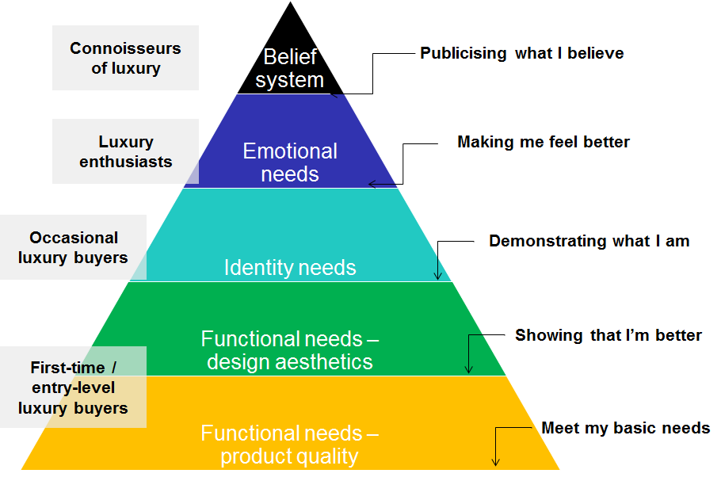
Classification of luxury consumers and their needs
Explorers
Epicureans
Budget Controllers
Sceptics
Base: 3,000 internet users aged 20-39
Source: QQSurvey/Mintel

Slide 25
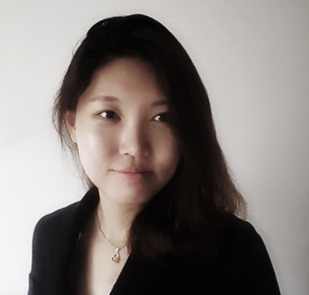
Alina Ma
Senior research analyst
info@mintel.com
mintel.com

